Slide 1
Scalable Data Analytics
SENG 550
AKA. Big Data - Data Engineering
Armin Zirak

Slide 2
Data Engineering
3

Slide 3
Types of Data
What data types exist in the world?

Slide 4
Data Types
Tabular Data: tables of orders, menus, customers.
Text: tweets, articles, reviews.
Text Databases such as ElasticSearch -> logger.log(“user clicked on the button”).
Image: product images on e-commerce sites.
Video: YouTube, surveillance systems, etc.
Audio: Spotify music, WhatsApp voice messages.
Each type of data has its own challenges in storage, processing, and analysis.

Slide 5
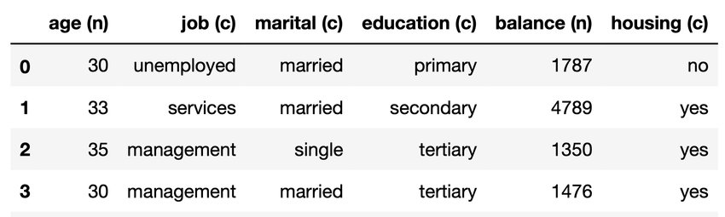
Tabular Data
Tabular data is the most common format.
Excel, Google Sheets, CSV files, etc are all tables.
The human brain understands tabular data easier.
Tabular data is the focus of this course.

Slide 6
SQL
SQL Queries are the most common tool to retrieve data.
select * from customers where customer_id = 3
select average(age) from customers;
Df[df[‘customer_id’] == 3]
We will learn SQL.

Slide 7
Data Engineering in Action
Customers place orders
Orders
Order
Software (Backend)
Order
Order
Order
Order
Order
Order
Order
Database
(e.g., MySQL, PostgreSQL)

Slide 8
Data Engineering - Example 1
Manager (BI): I want to calculate the last month’s revenue on Calgary orders …
Every time I run a query, it takes a long time.
Orders (5TB)
Query: Calculate Revenue on Calgary’s Orders
Software Engineer:
Whenever this guy runs a query, our database slows down.
select sum(profit - cost) from orders where location = ‘calgary’

Slide 9
Data Engineering - Example 1
Orders
Manager: Now I read from a smaller database and my queries won’t impact the main system.
calgary_orders
Data Pipeline
Query
select sum(profit - cost) from calgary_orders;
The new data pipeline moves calgary orders into the second database. So, if it moves data once a day, there is only one heavy query to the source table each day and that is under control of data engineers.

Slide 10

Data Engineering - Example 2
Data Scientist: I want to write a machine learning model to predict next months’ revenue
Orders
… But I can’t run my model on a database. I prefer it to be in a file format (e.g., CSV).
Also, my model reads all data for every test. I will need to run multiple tests each day, it’s going to hurt the main database.
Model Reads

Slide 11
Data Engineering - Example 2
Data Scientist: I’m back to my nature. I see a CSV file as the input.
Orders
A CSV file of orders
Data Pipeline
Model Reads
CSV files are a sample of usable format to most ML models.

Slide 12
Data Engineering - Example 3
Deliveries
Data Scientist: I want to develop a model that predicts whether or not the customer will receive its order faster if he gives more tips.
… I need to use historical data of past deliveries and tips but they are stored in separate databases or tables.
Data Pipeline
Tips
Merge
deliveries_tips.csv
Model Reads
Data Pipeline

Slide 13
Data Engineering - Example 4
Data Scientist: CSV files are too big. My Pandas + Scikit-learn library doesn’t work…
Data
Distributed Machines
Distributed Machines
Data Pipeline
Distributed ML Cluster
Distributed Machines
Distributed Machines
Distributed Machines

Slide 14
Data Engineering - Example 5
Data Scientist: Some fields have null values that I need to replace with 0. Some fields have trailing whitespaces that impact my models. I need to pre-process those fields everytime I run a model.
Data
Curated Data
Data Pipeline
BI: I have the same issues and even more. I see “$12” in tip column, and I need to remove ‘$’ and convert it into the number 12 for my mathematical expressions. I need to do this everywhere in every table.

Slide 15
Data Engineering
These examples are part of what we call Data Engineering in today’s industry.
Data engineering is the field of designing and building systems that collect, store, process, and manage large volumes of data to make it accessible and usable for data scientists, analysts, and other users.

Slide 16
Data Engineering
A data engineer’s main skill is understanding business needs (e.g., data size, downstream use cases) and picking the right tools.
Most tools are offered by major tech companies like Google Cloud Platform, Amazon Web Services, and Microsoft Azure. However, many smaller businesses and startups are also introducing new tools regularly.
Most tools are based on similar concepts, so learning the concepts helps you adapt to new tools faster.
In this course, we will focus on these core concepts and use a few tools like Spark as examples.

Slide 17
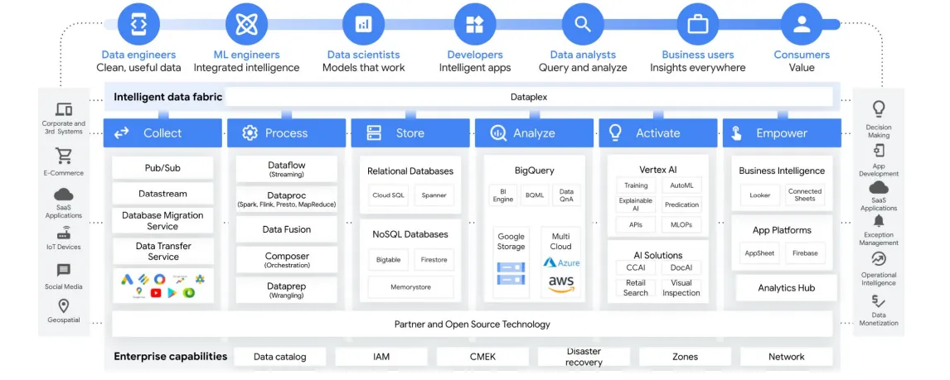
Big Picture
It’s fine if you don’t understand this picture.

Slide 18
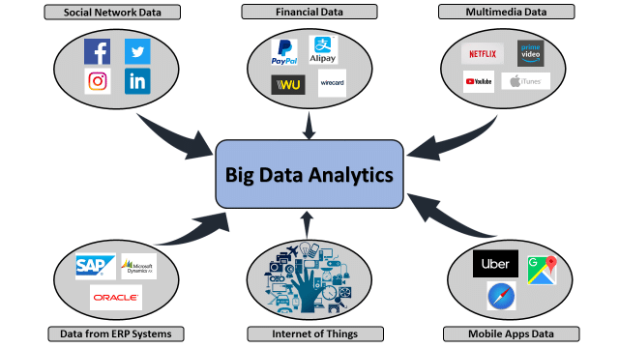
Data Sources

Slide 19
Separation of Software and Analytics
We discussed primarily there is a separation between Software and analytics zone. Let’s dive deeper.
Database
Database
Data Science (AI)
Software
Business Intelligence
Data Analytics
Software Zone
Analytics Zone

Slide 20
Separation of Software and Analytics
It’s important to have a distinct zone for analytics.
It protects the main software system from potential issues caused by data scientists, BI developers, etc.
While the software zone or databases are managed by software engineers, data engineers control the analytics zone.
The two zones have different characteristics. -> Next Slide

Slide 21
Separation of Software and Analytics
Smaller data
Software doesn’t need to store all data. E.g., details of user activities. Orders could be removed after some time.
Availability
Availability is crucial
Real-time
Continuous availability is critical, and data must be highly accurate.
Data has to be most accurate.
OLTP (Online Transaction Processing) Queries
select * from orders where id = '1';
select * from customers where id = '1';
Update customers set address = new_address;
Updates are common.
The system needs to respond quickly.
Data is large
History of orders could be needed for last three years.
Downtime is tolerable to some extent.
Delay is acceptable
Data scientists can tolerate receiving data with a delay, such as one hour later.
Data quality can be compromised
OLAP (Online Analytical Processing) Queries
select average(age) from customers where location = 'calgary';
Machine learning models normally process a big chunk of data in a subset of columns.
Updates are rare. (Immutable Data)
Queries can take time.
It can take a minute or more to feed data into an ML models.
Software Zone
Analytics Zone

Slide 22
Different technologies could be used.
Traditional databases like PostgreSQL and MySQL were designed to meet software needs; newer technologies have been invented to address analytics needs.
They are called Data Warehouses.
Snowflake
Google BigQuery
Amazon Redshift
Apache Druid (Open-source)
Data warehouses are specialized databases designed to handle analytic workloads more efficiently.
We will cover more technical details later in the course.

Slide 23
Let’s stop technical details here.

Slide 24
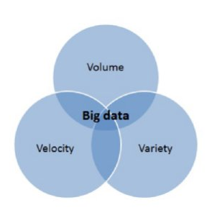
Big Data
Big Data was traditionally known with 3Vs.
Volume: The sheer amount of data generated every second.
Example: Every minute, millions of messages are sent on WhatsApp.
Velocity: The speed at which data is generated and processed.
Example: Streaming data from IoT sensors needs real-time processing.
Variety: Different types of data being generated.
Example: Tweets (text), photos on Instagram (images), and YouTube videos.
In today’s world, most data is just big data.

Slide 25
Data Engineering vs Data Science
Data engineering is different from data science. The concepts, techniques, and tools are also different. For example, data engineers use tools like Snowflake and SQL for building data pipelines, while data scientists use Scikit-learn and TensorFlow for building AI or ML models.
Data scientists often use the work of data engineers, but they aren’t the only ones. Many companies had data engineers before data science was common.
In smaller companies, data scientists might also have to do some data engineering work.
Both fields are data-aware, and some professionals swap between them.
Data Sources
Processed Data
Data Engineering
Data Science

Slide 26
Participation Quiz
Describe one difference between analytics and software zone.
Don’t forget to write down BOTH your name and UCID please!

